Slide 1
ES2016 & AngularJS
Build next generation webapps today

Slide 2
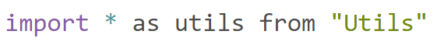
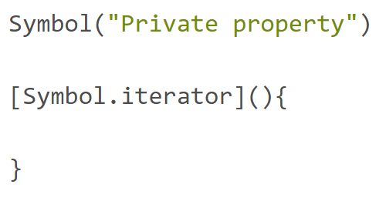
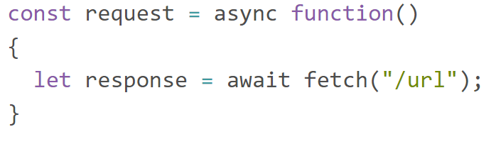
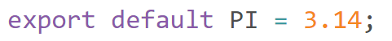
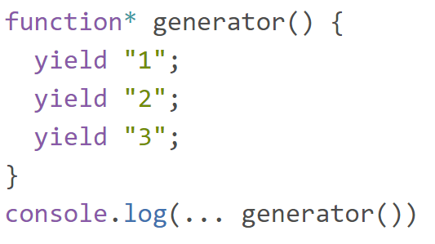
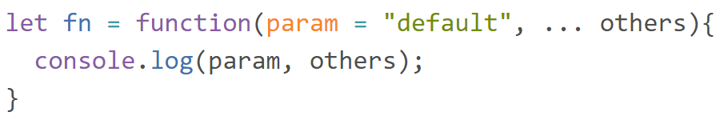
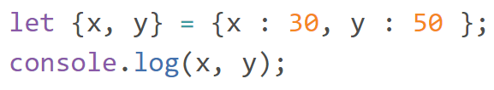
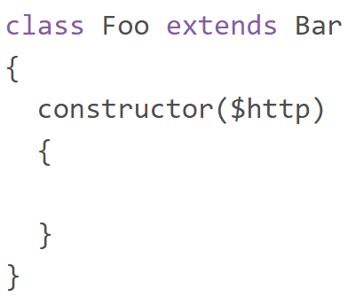
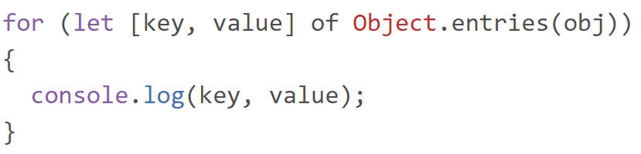

Slide 3
Topics
TC39
Classes & OOP
Modules
Let / Const
Arrow Functions
Rest / Spread
Destructuring
for … of / Iterators
Symbols
Generators
Async / Await
Object Enhancements
Transpiling

Slide 4
TC39
The people behind Javascript

Slide 5
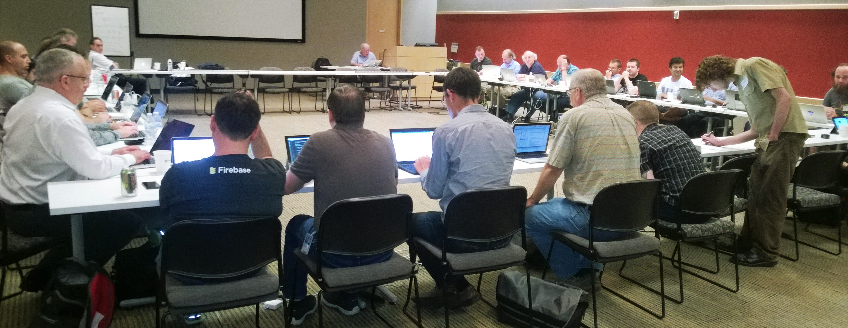

TC39
Specifies Ecmascript
Github
Annual Release
TC39 Process / Proposals

Slide 6
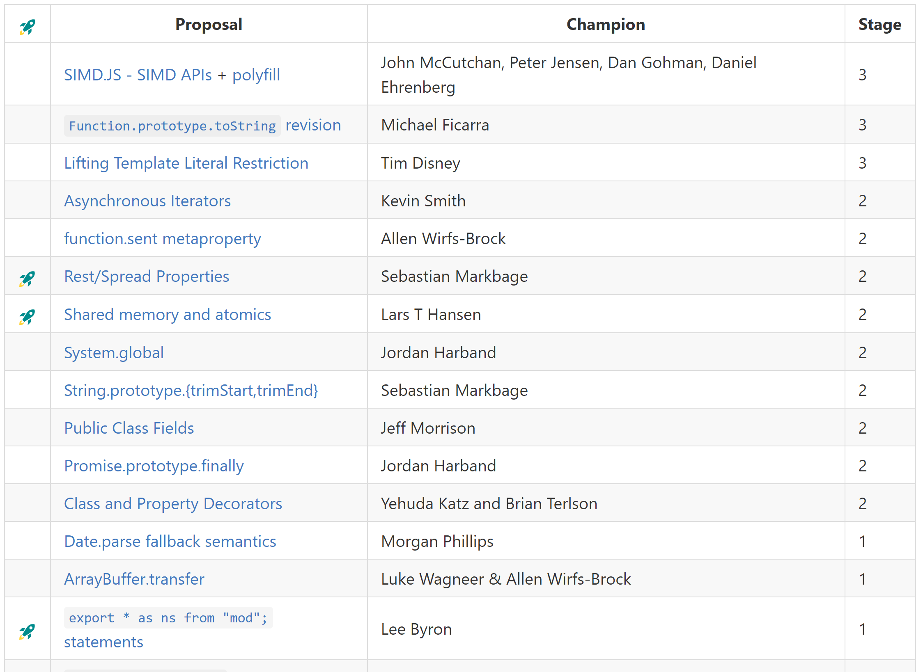
TC39 Process
Proposals
Champions
Stages
Stage 0 – Strawman
Stage 1 – Proposal
Stage 2 – Draft
Stage 3 – Candidate
Stage 4 - Finished

Slide 7
Classes
Javascript goes object oriented

Slide 8
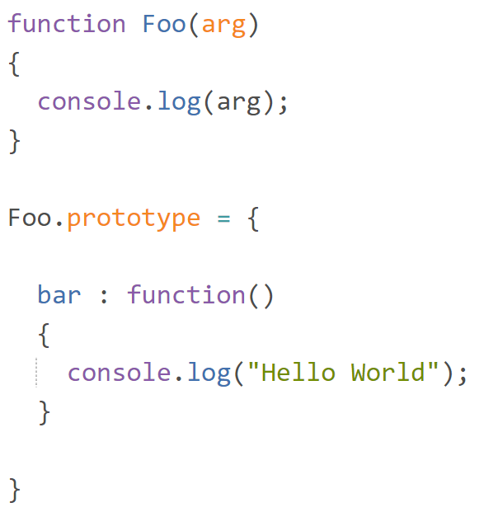
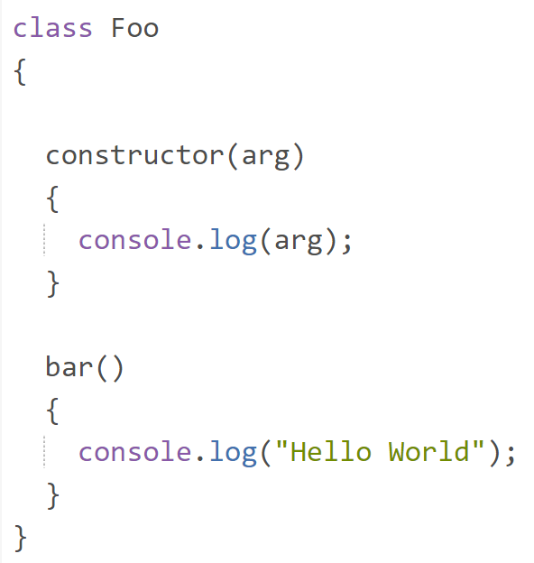
Class Definition

Slide 9
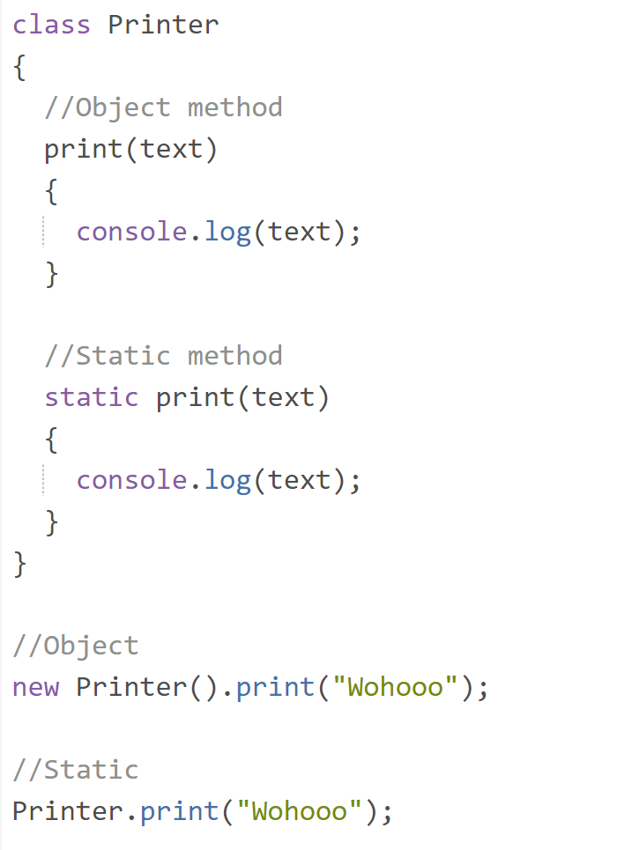
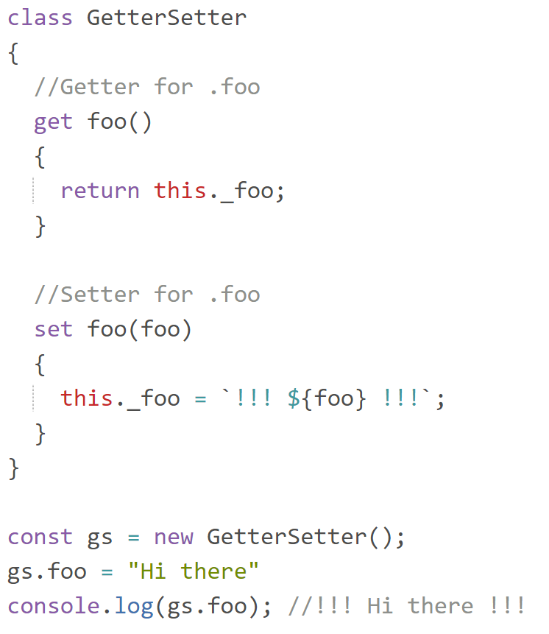
Methods / Getter / Setter

Slide 10
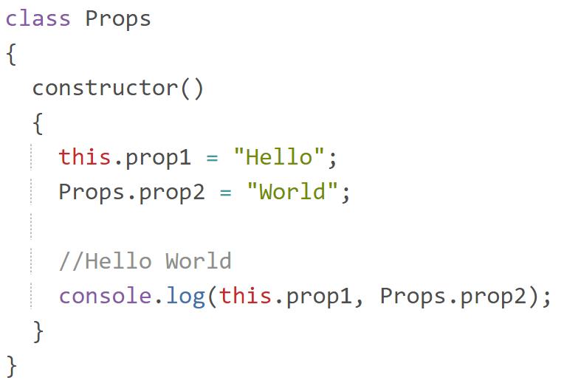
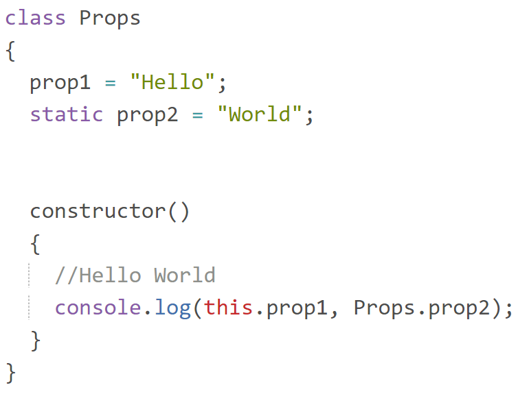
Class Properties
ES8

Slide 11
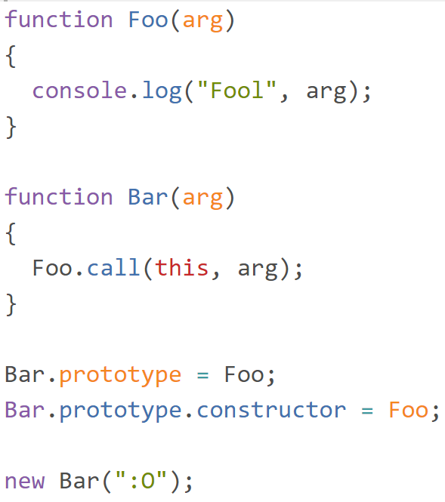
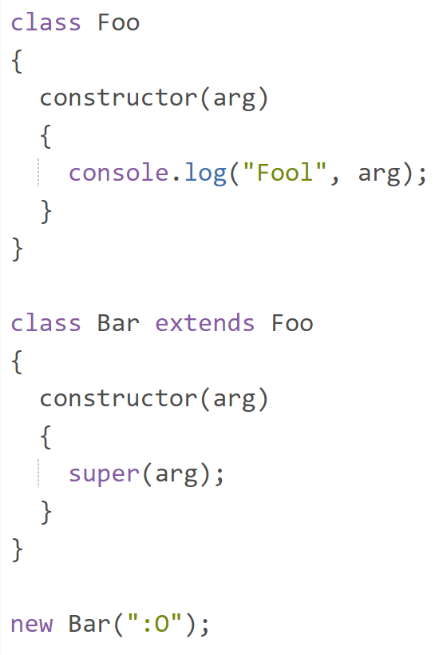
Extending

Slide 12
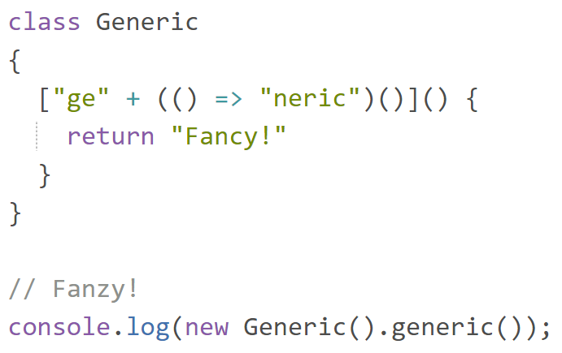
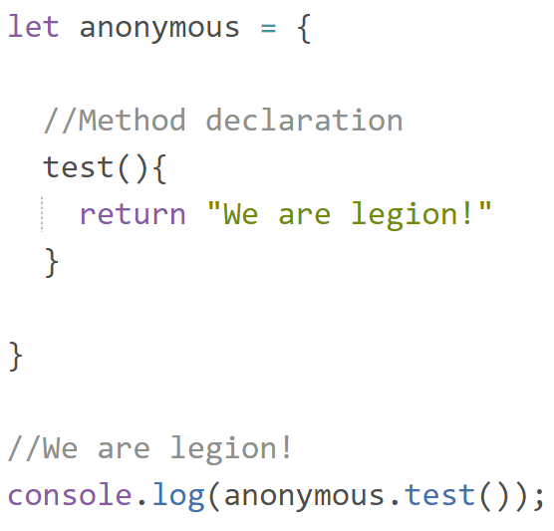
Generic Names / Anonymous Objects

Slide 13
Modules
Reusable and maintainable code

Slide 14
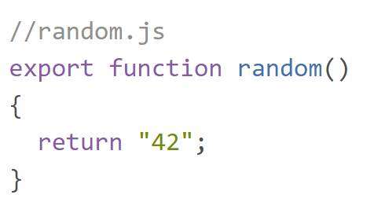
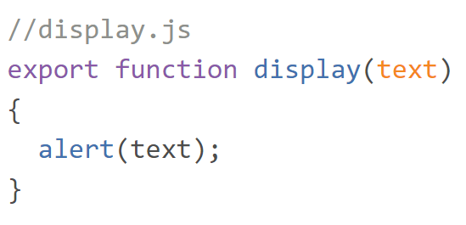
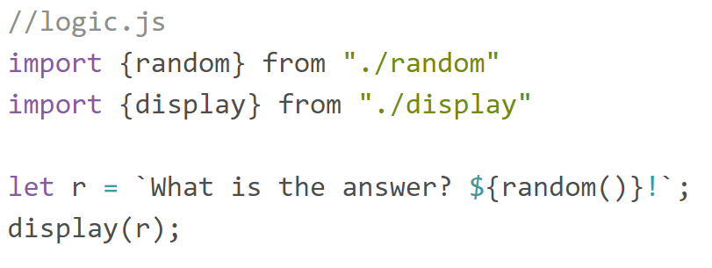
Overview

Slide 15

Whats the benefit?
Reusable Code
Single Responsibility
Lazy loading

Slide 16
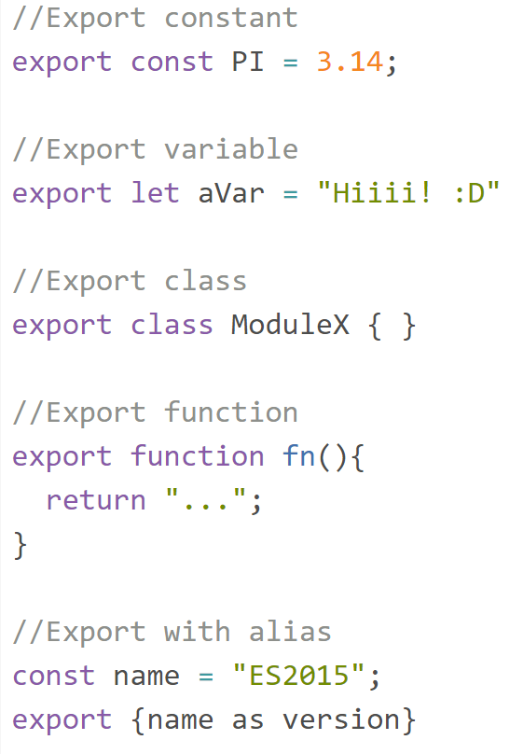
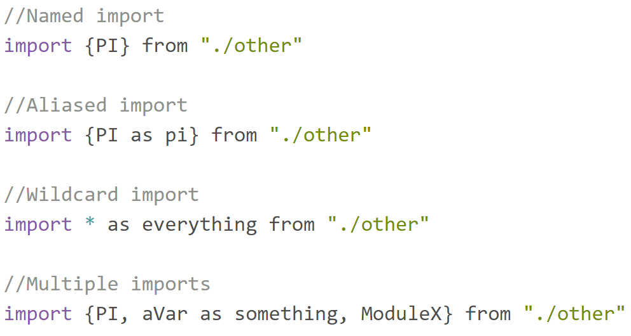
Syntax

Slide 17
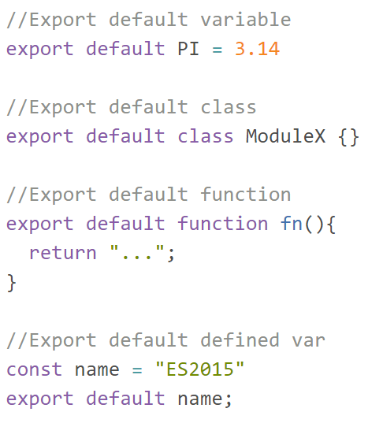
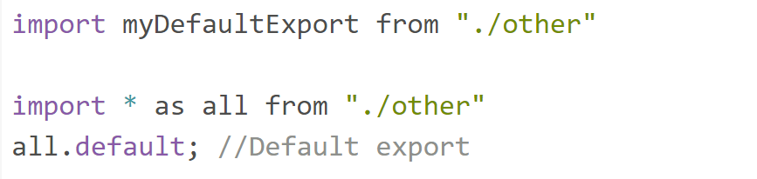
Default exports

Slide 18
let / const
Scoped variable declaration

Slide 19
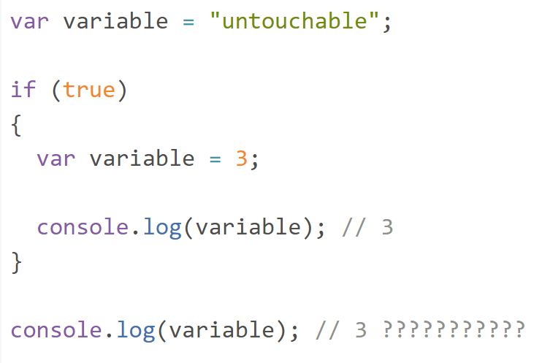
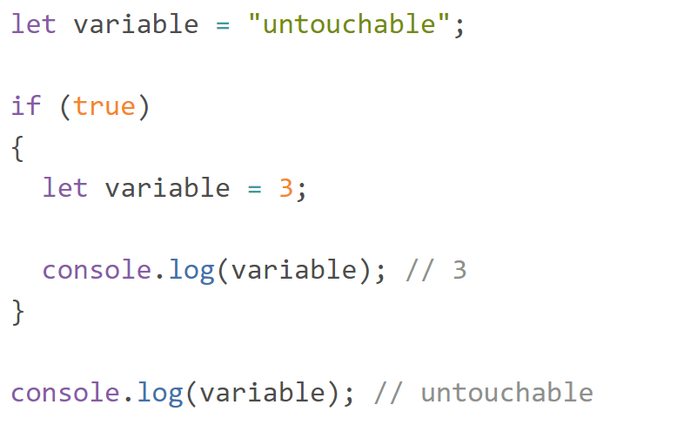
var vs let

Slide 20
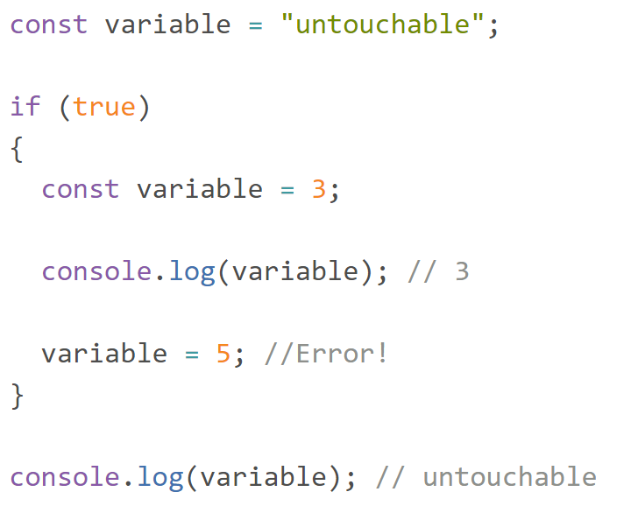
const

Slide 21

Conclusion…
let is only valid in the current scope
Always use let instead of var
const for unchangeable variables
var is dangerous!

Slide 22
Arrow Functions
Lambdas for Javascript

Slide 23
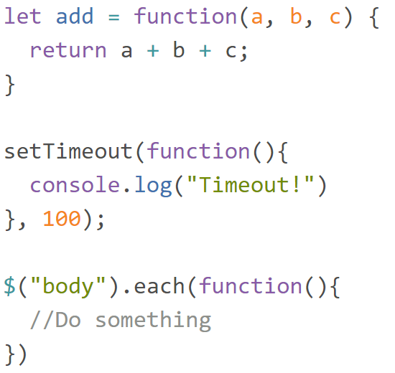
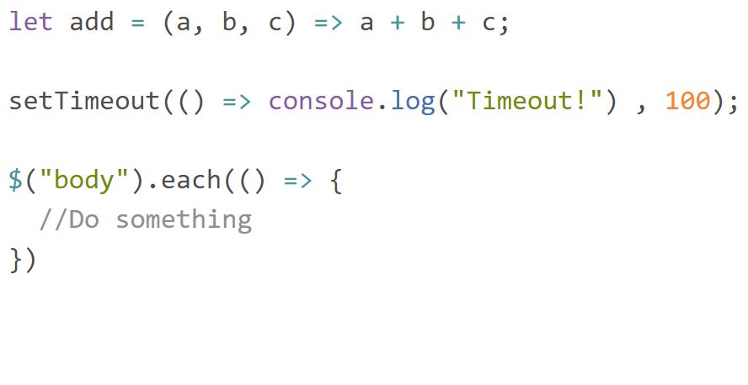
Syntax

Slide 24
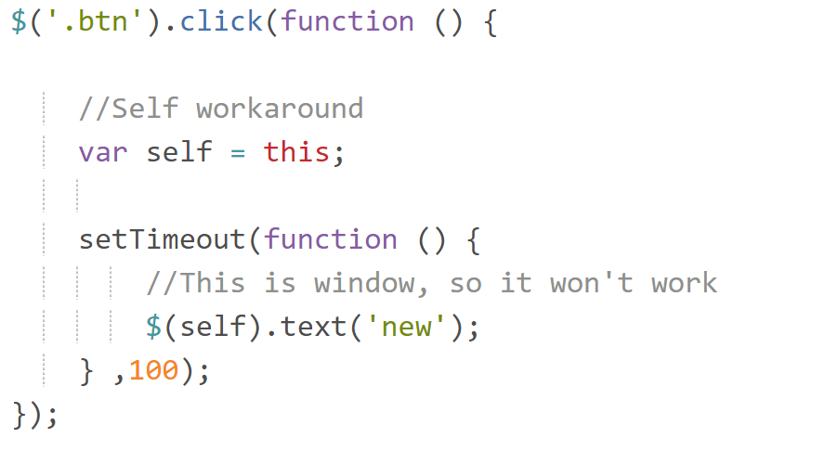
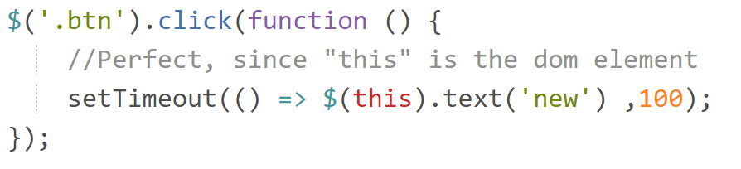
Lexical this
this inside an arrow function is always equals this of the outer scope

Slide 25
Rest / Spread

Slide 26
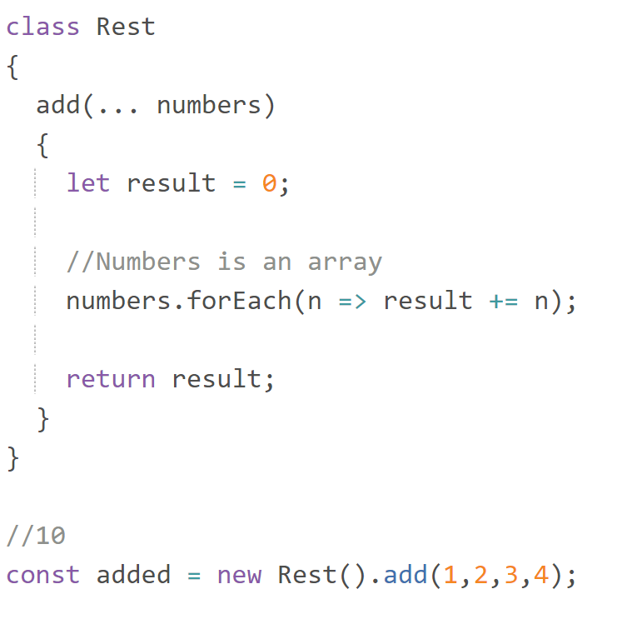
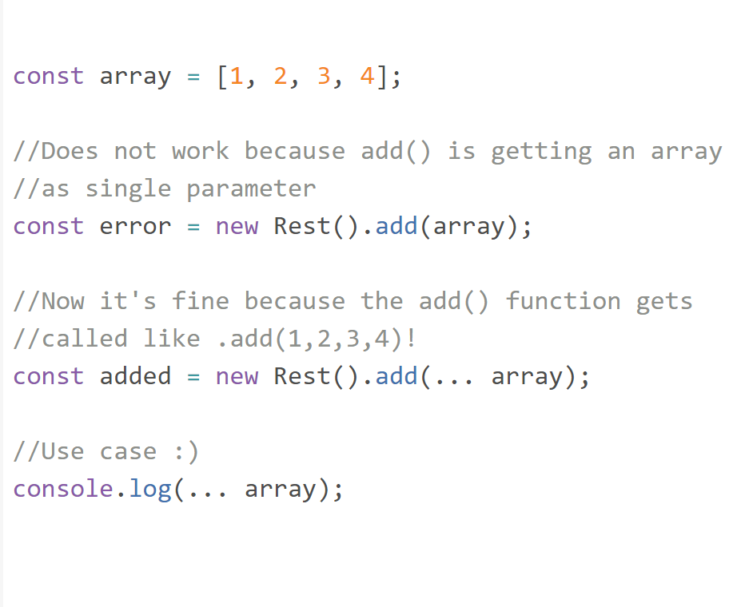
Rest / Spread Operator
Rest
Spread

Slide 27
Destructuring
Break an object into its parts

Slide 28
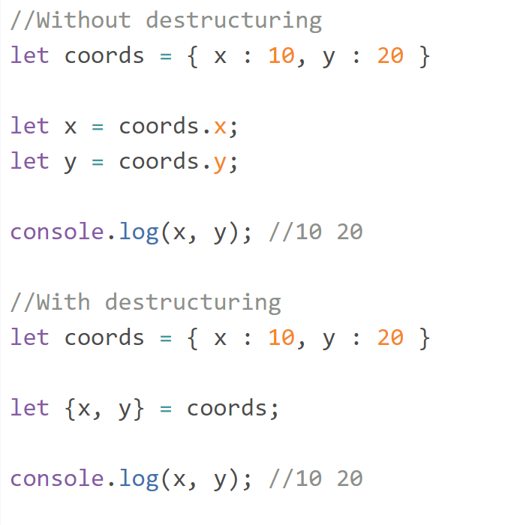
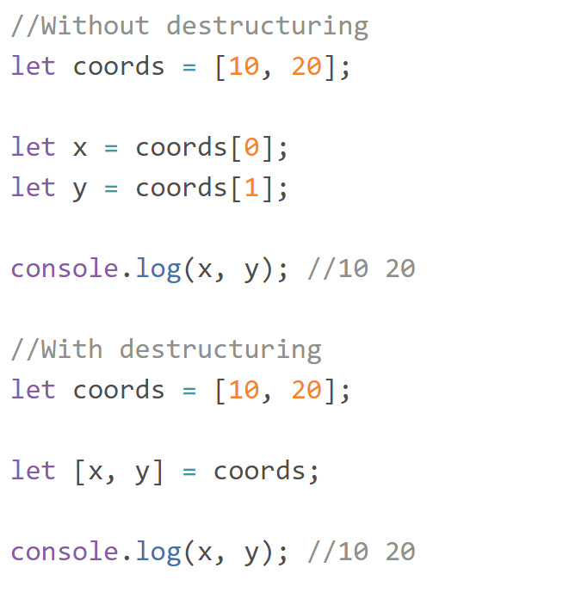
Basics
Objects
Arrays

Slide 29
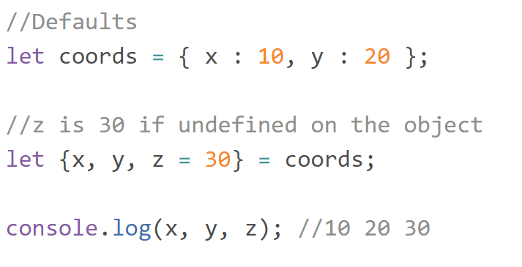
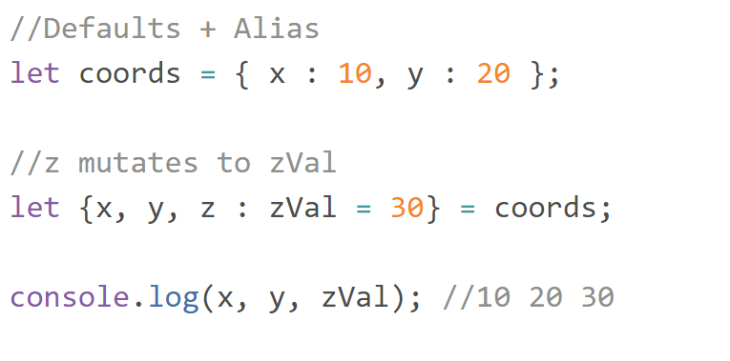
Basics
Defaults
Alias

Slide 30
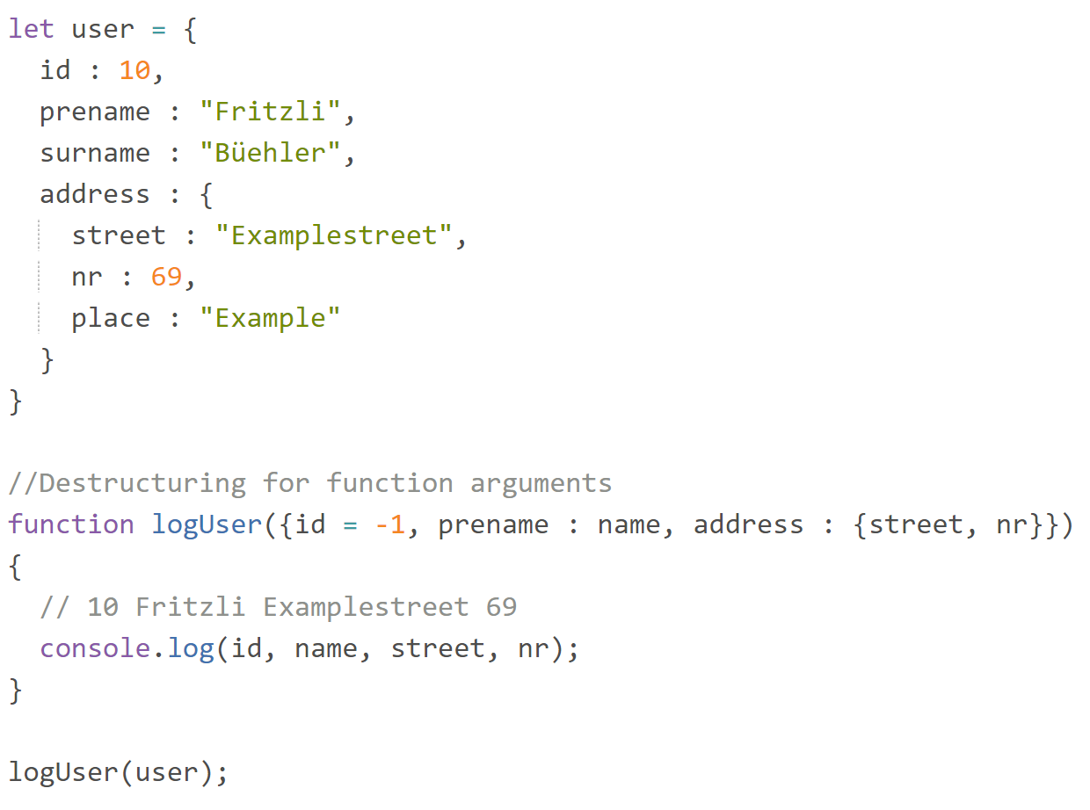
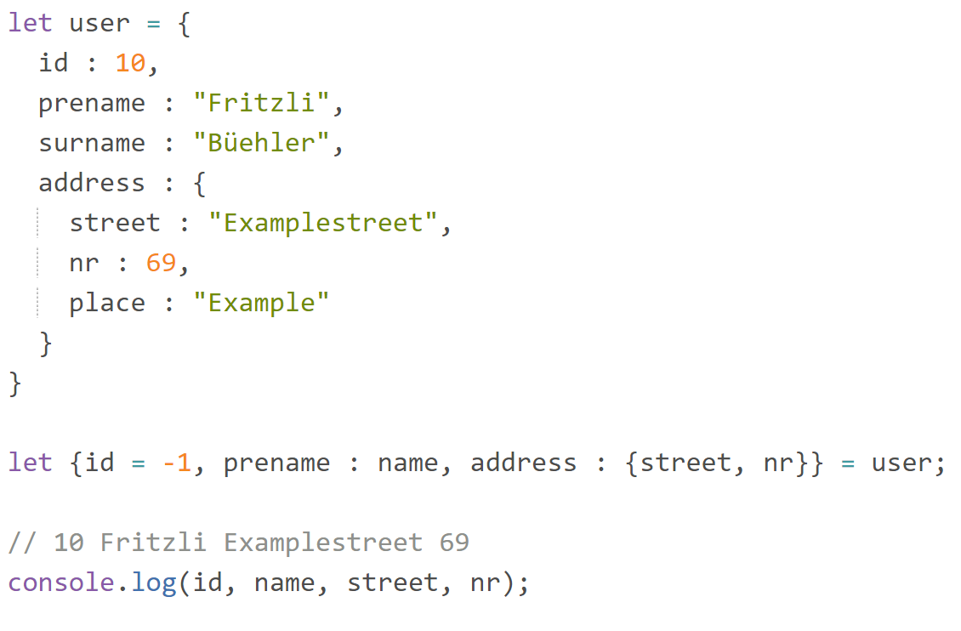
Advanced

Slide 31
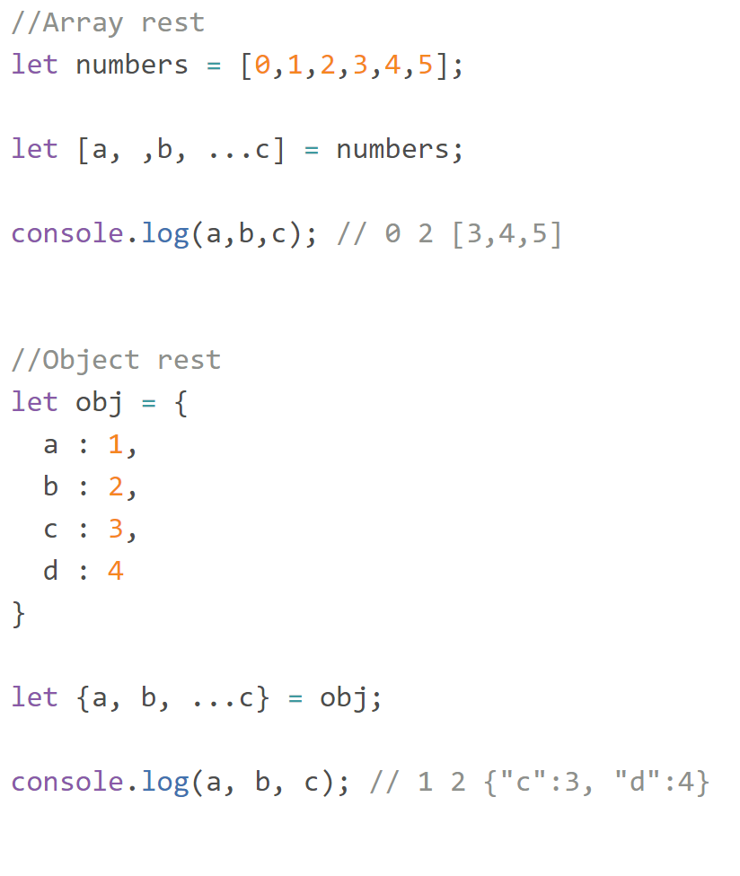
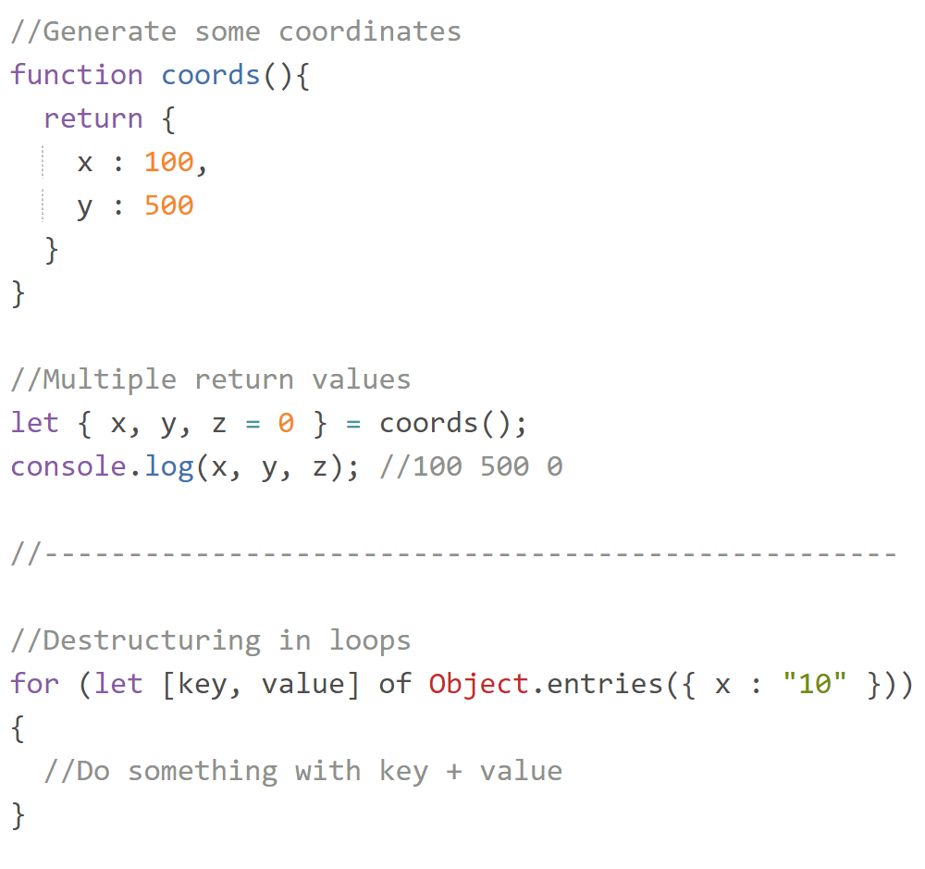
Advanced

Slide 32
for … of
Javscript get Iterators

Slide 33
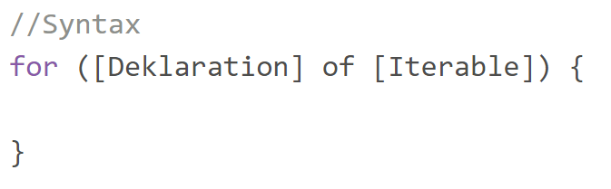
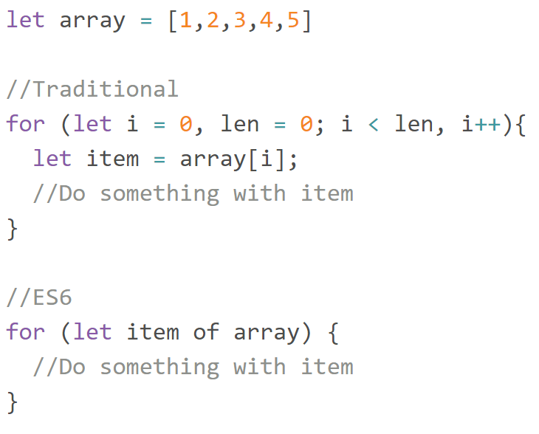
The for … of loop

Slide 34
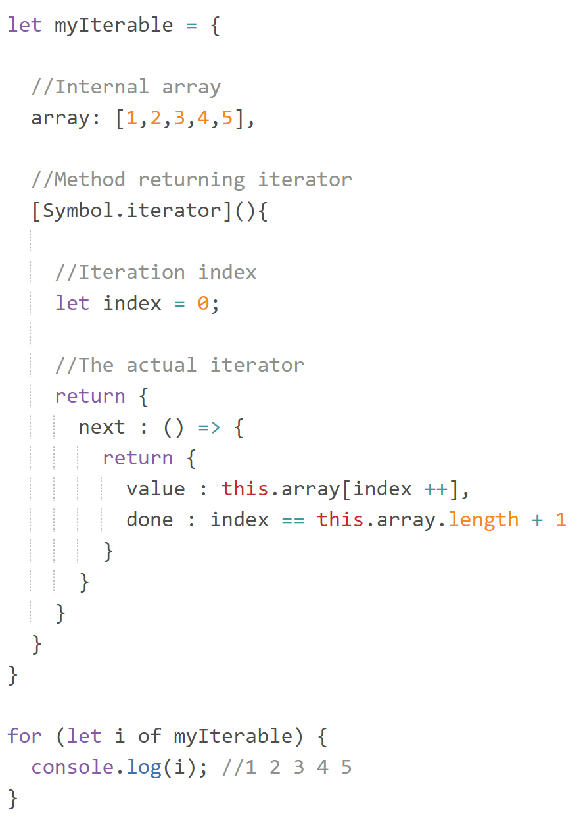
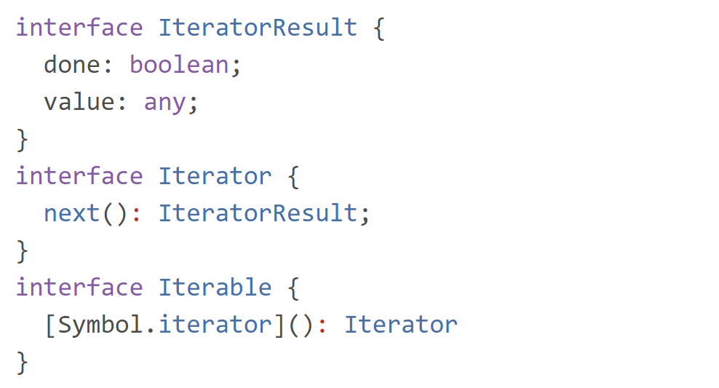
Iterable
With ES6 the Iterator Protocol arrived

Slide 35
Symbols
Symbol(«unique»)

Slide 36
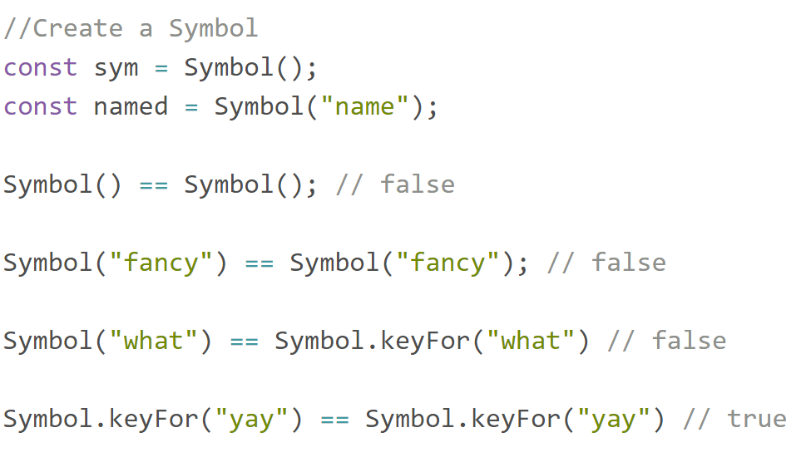
ES6 Symbols
Meta data
Private properties (+/-)
Global registry
Well known Symbols

Slide 37

Well known Symbols
Symbol.iterator
Symbol.toStringTag
Symbol.toPrimitive
Symbol.hasInstance
Symbol.species
Symbol.unscopables

Slide 38
Generators
function* (){ yield «awesome» }

Slide 39
Summary
A generator creates an iterable
The iterable may be infinite
Each .next() continues the generator
yield to pause the generator
yield* for generator delegation

Slide 40


Syntax

Slide 41


Specials
Input with .next(arg)
Arrow generators
return is NOT in the Iterator
Infinite loops

Slide 42

Delegation

Slide 43




Asynchronous Generators
+
+
=

Slide 44
Async / Await
await anything!

Slide 45


How?

Slide 46
Async Functions
async as function / method prefix
await is only allowed in async functions
Always returns a Promise
try / catch for asynchronous error handling
Native asynchronous generator

Slide 47


Return value

Slide 48


Error handling
Exception thrown by fetch() will dissapear!

Slide 49
General Enhancements

Slide 50
Methods
Objects
Array#find
Array#findIndex
Array#entries
Array#values
Array#keys
Array#includes
Object#assign
String#includes
Promise
Reflect
Map
Set
WeakMap
WeakSet

Slide 51
Transpiling
Transform ES6+ code to ES5

Slide 52





Slide 53


